Slide 1


Optimising employment delivery through utilising data insights from the jobseeker journey
Mark Abrahams, Head of Research and Analytics

Slide 2
Purpose of this session
How can we move from being ‘Data Rich Insight Poor’
to making insightful use of data ?
How can we make use of these data insights from the jobseeker journey to go beyond compliance/contractual reporting?
How can data be used to improve operational performance from a work coach and jobseekers perspective to predict outcomes and manage risk?

Slide 3
Data collection
All providers collect data
Most providers analyse and use data
Few maximise or get the most from their data
Data is information, often presented in a statistical format.

Slide 4
Exploring and using types of data
Descriptive – What happened?
Operational Reporting – collecting the right data
Diagnostic – Why did it happen?
Advanced Reporting e.g. Dashboards
Predictive – What might happen?
Prescriptive – How can we make it happen?
E.g. data models that evaluate possible future scenarios and their likelihood
Evaluative – Measuring the impact of interventions and improvements

Slide 5
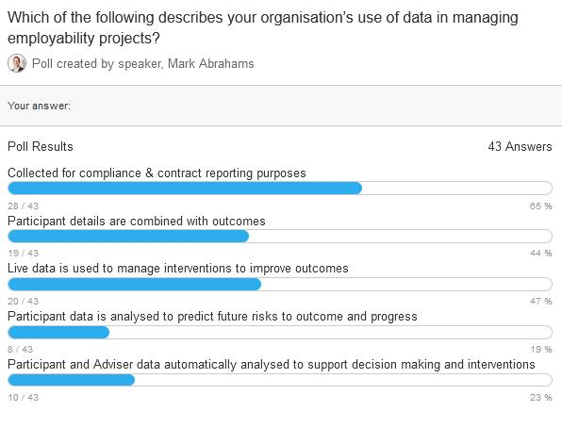
Quick Survey

Slide 6
Participant journey and data points along the route
Participant
SMT
SMART Action Plan
Online resources (Date/time)
Progress Review
(Date/time)
Action Plans
(4 weekly)
Participant Pipeline
Diagnostic Assessment
Online Job Search
(tracked)
Workshop (e.g. CVs)
Diagnostic
(4 mths)
Job Search
(tracked)
Contact details
JCP Engagement
Caseload/
Resourcing
Warm Handover
Initial Meeting
On programme activity
F2F Meeting /Review
On programme activity
Milestones & Outcomes
Partner Engagement
. . .
Governance and Oversight
Cohort Progress
Start Date
Case owner allocation
Work Coach
Withdrawals
Identify barriers
Review Actions
Review(s) Actions
Outcome Tracking and follow-up
Activity Tracking (Date/time)
Fortnightly Contact
(Date/time)
Initial Engagement Activity
Identify opportunities
Outcome Payments

Slide 7
Missing data points?
Are there more opportunities to collect different/further data?
Example: Focusing on participants
Do you have data evidence in response to:
Have participants raised all risks and barriers that affect their job search?
Do participants have sufficient confidence to search for work?
Are participants sufficiently motivated to succeed?
Are face-to-face meetings of good quality
Is employment support individualised and of good quality?
The data we collect influences what we can:
Evidence
Improve

Slide 8

Defining the business question

Slide 9
Which critical business questions do you need to answer?
How can we improve resourcing?
How can we improve quality?
How can we manage payments & funding?
How can we improve delivery?
How can we identify risks?
Operations
Compliance
Strategy

Slide 10

How can data analytics help your organisation to develop
Operational Challenges

Slide 11
Operational Challenges 1
Customer Service Standards
How long is the delay between Referrals and Initial Meetings?
How long after Referral is the Diagnostic Assessment completed?
How long after Referral is the initial Action Plan agreed with the participant?
Is 1-2-1 support with participants occurring fortnightly?
Is every participant receiving a four-weekly face-to-face review meeting?
Are action plans reviewed every four weeks?
Are diagnostic assessments completed every four months?
How can we promote customer satisfaction?

Slide 12
Operational Challenges 2
Participant Focused
How do we monitor participants' engagement in the service?
Which participants are making progress?
Which participants are struggling with their action plan?
Which learners have not attended their face-to-face meeting?
Which learners have not had contact with their work coach in the past fortnight?
What is the ‘did not start’ rate? What data do we have?

Slide 13
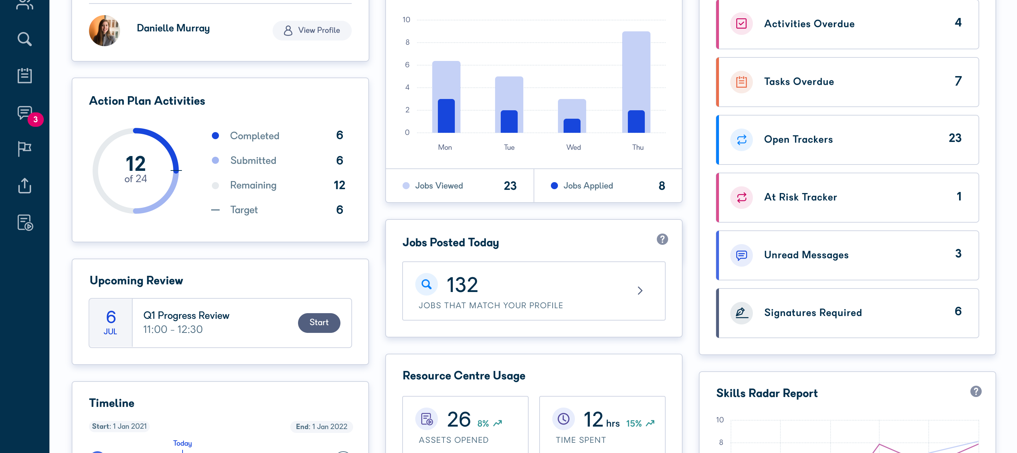
Participant Activity

Slide 14
Operational Challenges 3
Work Coach Focused
Which work coaches are on top of their caseload?
Which work coaches are failing to be responsive?
How do we performance manage the team?
Content/Quality of Resources
Which online learning resources are effective?
Which do not engage jobseekers?
What are the levels of workshop attendance and outputs?

Slide 15
Operational Challenges 4
Outcomes / Financials
How many jobs achieved in full-time vs part-time?
What is the current and projected outcome rate?
What are the expected outcome earnings for the next three months?
How many participants have been mandated?
How many participants are not showing progress or engagement?
What data is there on the pipeline of new referrals?

Slide 16
Using the right tools – MS Excel or alternatives?
Which tools do you typically use for data analysis and presentation?
Outputs:
Presented in a consumable format?
Clearly show key headline metrics?
Can be automated to reduce manual effort and errors?
Allows governance to scrutinise relevant details?

Slide 17
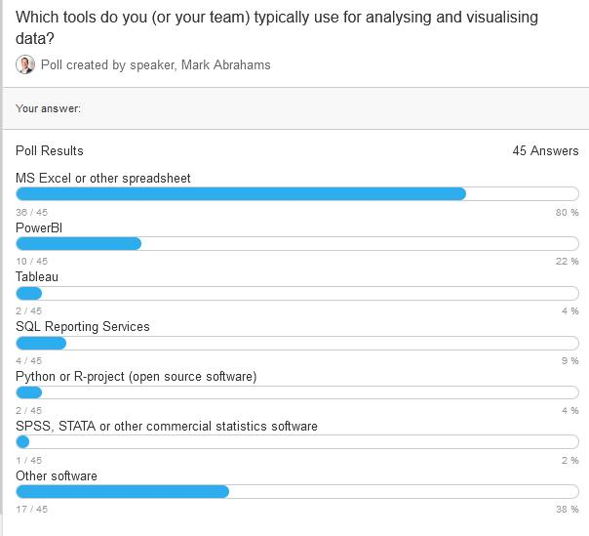
Quick Survey

Slide 18
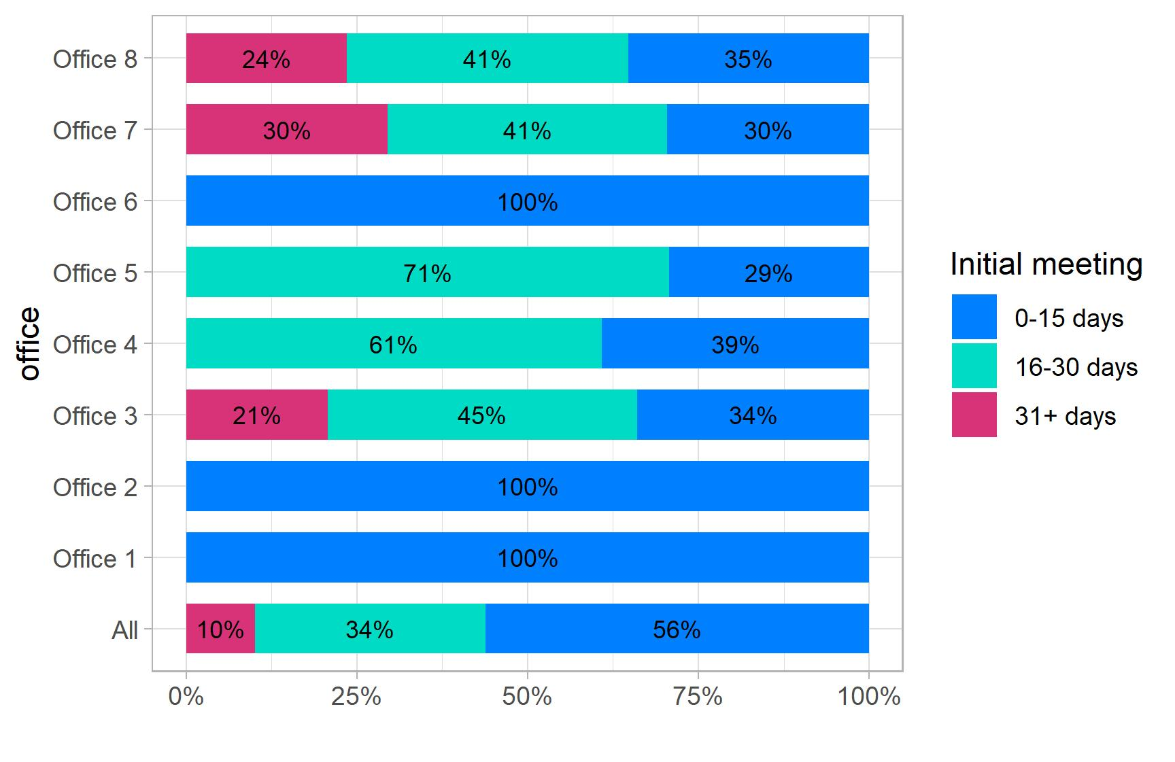
Visualising and Analysing Trends

Slide 19
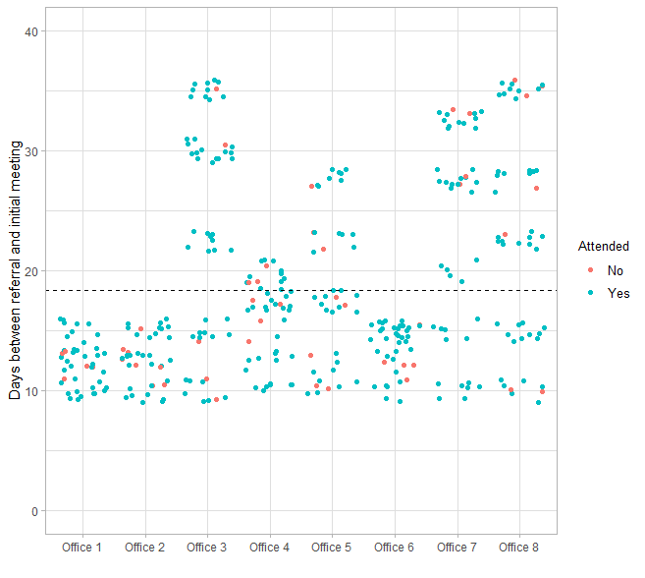
Visualising and Analysing Trends

Slide 20
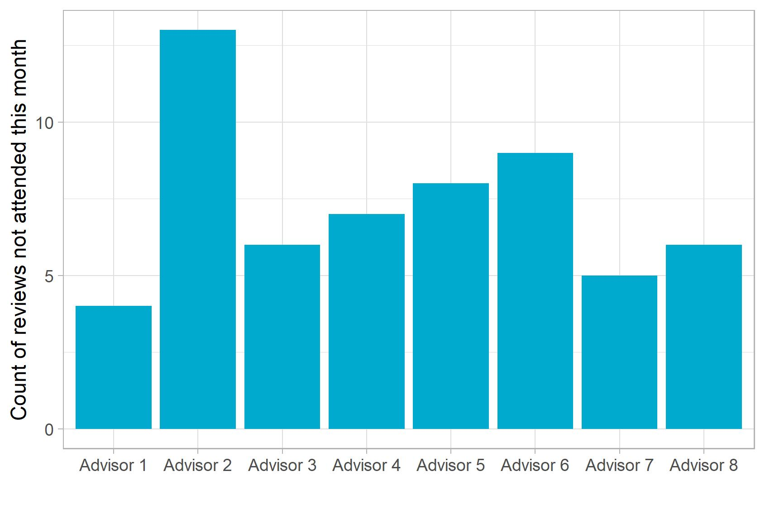
Visualising and
Analysing Trends

Slide 21

How can data analytics help your organisation to develop
Compliance Challenges

Slide 22
Monthly Performance Reporting
RESTART Monthly Performance Return can include:
Current caseload sizes per Work Coach/Key Worker
Current level of staff resourcing assigned to Restart
Details of all Participants not having received a Face-to-Face intervention in the reporting period.
Provider data on performance against the Customer Service indicators

Slide 23
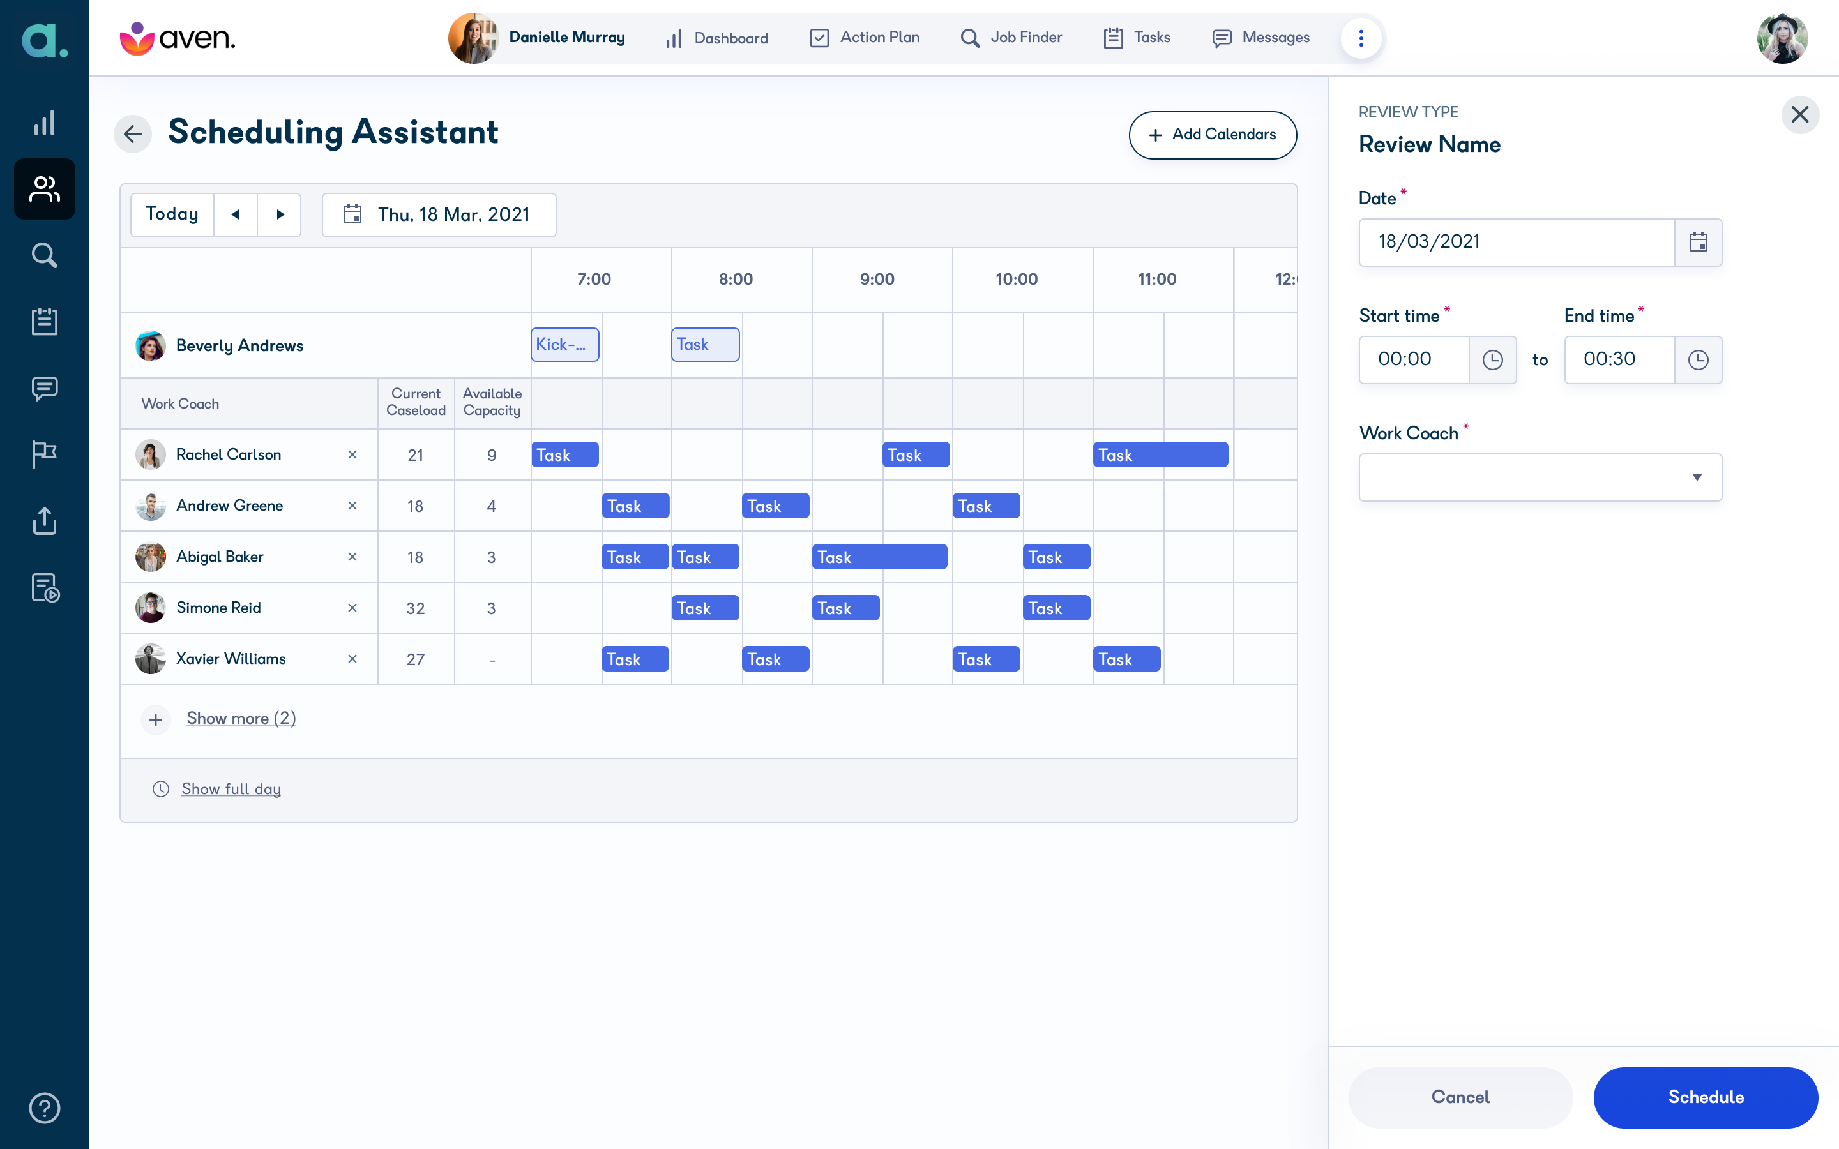
How many learners have missed their face-to-face meeting?

Slide 24

How can data analytics help your organisation to develop
Strategic Challenges

Slide 25
The Importance of Data and Analytics
Business & Strategic Challenges
How accurate is our data?
Where is the market going?
Which programmes are our strengths?
Where should we develop our provision?
Which programmes are most profitable?
Do we have ready access to relevant data?

Slide 26
Building a Data Culture
A data-driven culture relies upon
Democratisation of data access
  Who has access to the data or rather insights
Data Reporting
  Detailed tables vs Relevant charts / KPI indicators
Data Literacy
  Detailed tables vs Relevant charts / KPI indicators
Impact on people
  People still think their intuition is better than the data

Slide 27
Accurate, accessible, timely data
Better insight will impact:
Participant/Jobseeker outcomes
Participant experience
Organisational effectiveness
Financial outcomes

Slide 28
Take Aways
Data and Analytics will add significant value
Focus on key business questions
  Don’t let the analyst or data drive analytics
Consider what relevant data is actually needed
Reporting of insights
  Dashboards and ‘So what?’ - actually answering the business question
Acceptance of data insights
  Develop your organisation’s data culture

Slide 29

Questions & Comments

Slide 30
mark.abrahams@aptem.co.uk

